Slide 1
18ISL67 – File Structures Lab with Mini project
DEPARTMENT OF INFORMATION SCIENCE AND ENGINEERING
VOTER ID MANAGEMENT SYSTEM
Guide
Student Name
N L PRASAD & SACHIN D
1RF20IS033 &1RF20IS044
Name of the faculty
Dr. Vinoth kumar
Designation
Associate professor
USN
Dept. of ISE, RVITM
1

Slide 2
Index
Objective
Abstract
Introduction
File Structures Technologies Used
Implementation
Results
Conclusion
Bibliography / References

Slide 3
Objectives
- Develop a centralized database to store voter information securely.
- Create a user-friendly interface for voter registration and data entry.
- Implement robust search and retrieval functionalities for quick access to voter records.
- Establish authentication and verification mechanisms to ensure the accuracy and integrity of voter data.
- Enable efficient tracking and management of voter IDs, including issuance, renewal, and cancellation.
- Generate comprehensive reports and statistics for data analysis and decision-making.
- Implement data backup and disaster recovery mechanisms to prevent data loss.
- Ensure compliance with relevant legal and regulatory requirements for voter ID management.
- Improve data privacy and security measures to protect sensitive voter information.
- Facilitate seamless integration with other election management systems for efficient workflow.
- Provide user training and support to ensure smooth adoption and usage of the system.
- Enhance system scalability and performance to accommodate growing voter populations.
- Foster transparency and accountability in the management of the voter ID system.
- Streamline administrative processes and reduce manual paperwork through automation.
- Conduct regular system audits and security assessments to identify and address vulnerabilities.

Slide 4
Abstract
The VOTER ID System provides a user-friendly, interactive Menu Driven Interface (MDI) based on local file systems. All data is stored in files on disk. The system uses file handles to access the files. This System is used by the person to view his/her VOTER ID details. The system is initially used to add person records containing the V_ID, name, dob, address, gender. The system can then be used to search, delete, modify or display existing records of all the citizens .In the VOTER ID System, the V_ID field is a character array that can hold a numeric value of some maximum size. The size of the array is larger than the longest string it can hold. We preserve the identity of fields by separating them with delimiters. We have chosen the vertical bar character, as the delimiter here.
In this System, we have a fixed number of fields, each with a maximum length, that combine to make a data record. Fixing the number of fields in a record does not imply that the size of fields in the record is fixed. The records are used as containers to hold a mix of fixed and variable-length fields within a record. We have 5 contiguous fields. We use a B+ TREE of indexes to keep byte offsets for each record in the original file. The byte offsets allow us to find the beginning of each successive record and compute the length of each record. We look up the position of a record in the B+TREE, and then seek to the record in the data file. Our choice of a record delimiter for the data files is the end-of-line (new-line) character (\n).

Slide 5
Introduction
The Voter ID Management System provides a user-friendly, interactive Menu Driven Interface (MDI). All data is stored in files for persistence. The mini project uses 2 files: An Index file, to store the primary index, a Data file, to store voter records like voter ID, name, address, dob etc. and a secondary index file.
Introduction to File Structure
A file structure is a combination of representations for data in files and of operations for accessing the data. A file structure allows to read, write, and modify data. It might also support finding the data that matches some search criteria or reading through the data in some particular order. An improvement in file structure design may make an application hundreds of times faster. The details of the representation of the data and the implementation of the operations determine the efficiency of the file structure for particular applications.

Slide 6
Introduction
The current voter ID management system faces several challenges, necessitating the development of a more efficient and secure solution. The existing system relies on manual processes, resulting in time-consuming tasks, potential errors, and limited accessibility to voter information. The lack of a centralized database leads to data redundancy, inconsistency, and difficulty in data retrieval and analysis. Moreover, the absence of robust authentication mechanisms poses a risk of unauthorized access and tampering of voter records. To address these issues, an improved voter ID management system is required to streamline processes, enhance data security, and ensure accurate and accessible voter information.

Slide 7
File Structures Technologies Used
Field Structures
The four most common methods as shown in Fig. 1.1 of adding structure to files to maintain the identity of fields are: Force the fields into a predictable length. Begin each field with a length indicator. Place a delimiter at the end of each field to separate it from the next field. Use a“keyword=value” expression to identify each field and its contents.
Method 1:
Fix the Length of Fields In the above example, each field is a character array that can hold a string value of some maximum size. The size of the array is 1 larger than the longest string it can hold. Simple arithmetic is sufficient to recover data from the original fields
Method 2:
Begin Each Field with a Length Indicator We can count to the end of a field by storing the field length just ahead of the field. If the fields are not too long (less than 256 bytes), it is possible to store the length in a single byte at the start of each field. We refer to these fields as length-based.

Slide 8
File Structures Technologies Used
Method 3:
Separate the Fields with Delimiters We can preserve the identity of fields by separating them with delimiters. All we need to do is choose some special character or sequence of characters that will not appear within a field and then insert that delimiter into the file after writing each field. White-space characters (blank, new line, tab) or the vertical bar character, can be used as delimiters.
Method 4:
Use a “Keyword=Value” Expression to Identify Fields This has an advantage the others don‟t. It is the first structure in which a field provides information about itself. Such self-describing structures can be very useful tools for organizing files in many applications. It is easy to tell which fields are contained in a file

Slide 9
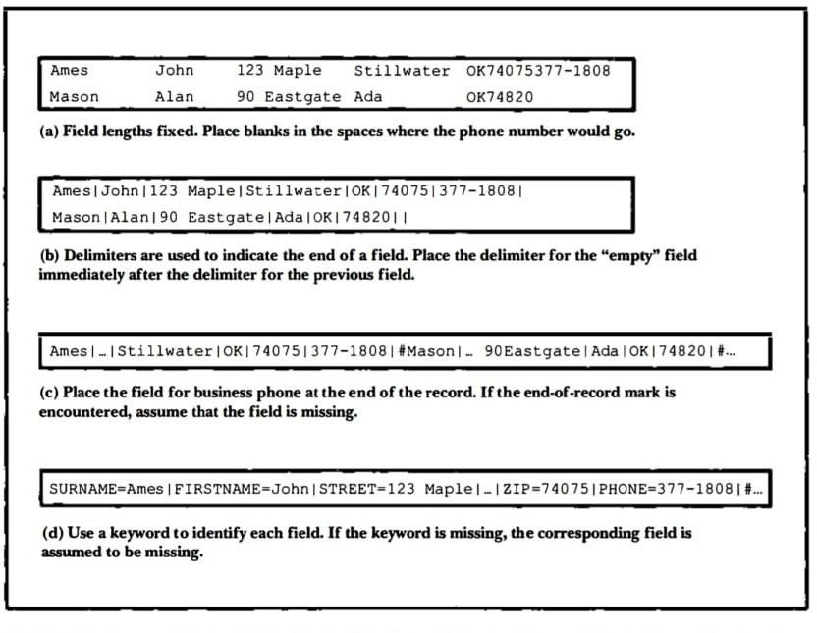
File Structures Technologies Used
Figure 1.1 Four methods for field structures

Slide 10
Implementation
Indexing Used
B+TREE
A B+TREE of simple indexes on the primary key is used to provide direct access to data records. Each node in the B+TREE consists of a primary key with the reference to record
The primary key field is the V_ID field while the reference field is the starting byte offset
of the matching record in the data file. Each B+TREE node can have max of 2 child node.
The V_ID is stored in the B +TREE, and hence written to an index file. On retrieval the matched V_ID is used, before it is used to seek to a data record, as in the case of requests for a search, delete, modify operation. As records are added, nodes of the B+ TREE undergo splitting (on detection of overflow), merging (on detection of underflow) or redistribution (to improve storage utilization), in order to maintain a balanced tree structure. The data files are entry-sequenced, that is, records occur in the order they are entered into the file.

Slide 11
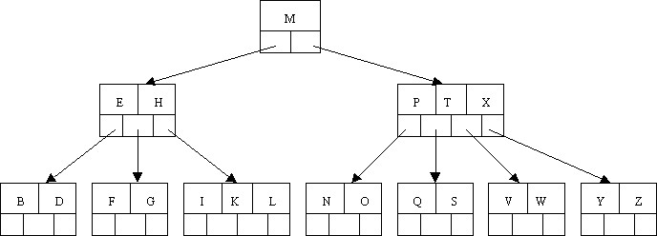
Implementation
The contents of the index files are loaded into their respective B - TREEs, prior to use of the system, each time. Each B+TREE is updated as requests for the available operations are performed. Finally, the B +TREEs are written back to their index files, after every insert, delete and modify operation.

Slide 12
Implementation
Pseudocode
Insertion Module
The insertion operation is implemented by append() function which adds index objects to the B-Tree if the V_ID entered is not a duplicate. It makes calls to other recursive and non- recursive functions.
void append()
{
student std;
int flag=1, pos;
fstream file("student.txt",ios::app); std.Input(0);
file.seekp(0,ios::end);

Slide 13
Implementation
pos=file.tellp(); flag=s.Insert(std.URN,pos);
if(flag && std.Pack(file)) cout << "\n\t Done...\n"; else cout << "\n\t Failure.";
file.close();
}
int SSET :: Insert(char *val,int disp) // function to insert key in block
{
int i=0;
BK x=FindNode(val);
for(i=0;i<x->cnt;i++) if(strcmpi(x->keys[i],val)==0)
{
cout<< " \nkey "<<val<<" is repeated \n"<<endl; return 0;
}
if(x->cnt < 4)

Slide 14
Implementation
{
for(i=0;i<x->cnt;i++)
if(strcmpi(x->keys[i],val)>=0) break; if(strcmpi(x->keys[i],val)==0)
//cout<< " key "<<val<<" is repeated "<<endl;
cout<<"";
else { int d=i;
i=x->cnt-1; while(i>=d)
{
strcpy(x->keys[i+1],x->keys[i]); x->disp[i+1]=x->disp[i];
i--;
}
strcpy(x->keys[d],val); x->disp[d]=disp;
x->cnt++;
} }
bt.create();
}
return 1;

Slide 15
Implementation
Display Module
The display() function displays the all the records in the order we have entered by accessing each index object stored at each node. The byte offsets in the objects are used to retrieve and display the corresponding data record fields.
void display(node * p)
{
int i,j; student std;
if(p->isLeaf())
{
fstream file("student.txt",ios::in); if(file.fail())
{
gotoxy(24,10);
cout<<"!!! ...The File Is Empty... !!!";

Slide 16
Implementation
getch(); return;
}
cout<<"RECORDS : "<<p->cnt; cout<<"\n********************************************************"; for(i=0;i<p->cnt;i++)
{
block * t=p->ptr[i]; for(j=0;j<t->cnt;j++)
{
file.seekg(t->disp[j],ios::beg); if(std.Unpack(file))
{
std.Display();
cout<< "\n\t\t\t\t Press any key ...\n"; cout<<"\n********************************************************";
getch();
}
else break;
}
}
file.clear();

Slide 17
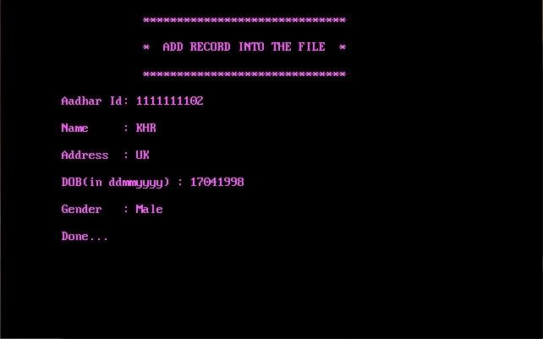
Results
Insertion: Inserting a new voter record. Each voter record should have unique Voter ID as shown in figure 1.3.

Slide 18
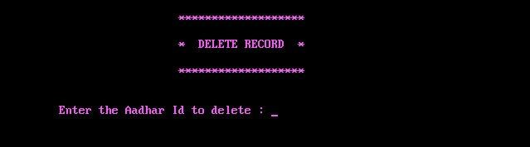
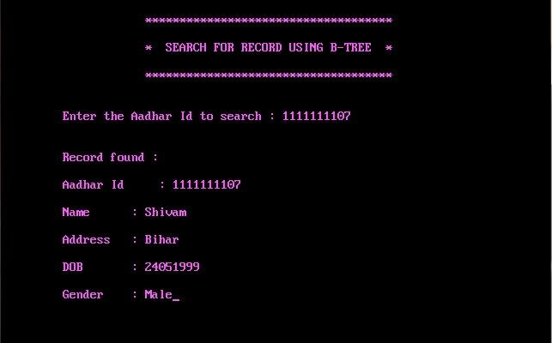
Results
Deletion of a product: Deleting the voter record by giving voter name as input as shown in figure 1.4
.
Searching of a Product: Searching the voter record by giving voter‟s name as searching key as shown in figure 1.5

Slide 19
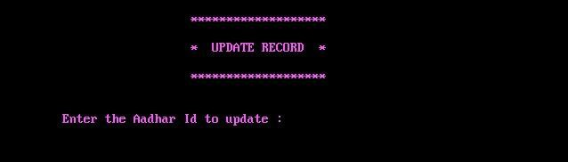
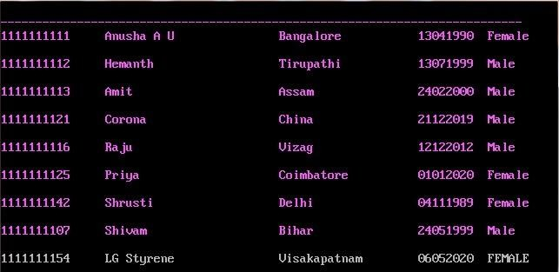
Results
Updating of a Details: Updating the voters details using V_ID as a primary key as shown in figure 1.6.
Data file contents: Stored details of voter record in datafile. `$` indicates deleted and modified voter record as shown in figure 1.7.

Slide 20
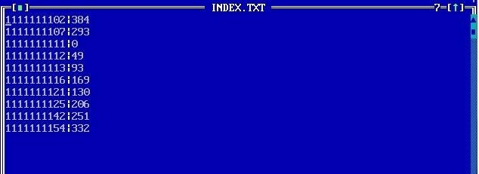
Results
Index File Contents: Index file contains secondary key and primary reference in it as shown in figure 1.8.

Slide 21
Conclusion
This system helps to store the voter details in the Voter ID electronically. The stored details of the voters are secured and can be retrieved at any point of time. This system reduces the amount of manual data entry and gives greater efficiency. The User Interface of it is very friendly and can be easily used by anyone. It also decreases the amount of time taken to write voter details and other modules. Hence this system is performing all the tasks accurately and is doing the work for which it is made.
We can enhance this system by including more facilities like adding specific user details such as his other government ID proof details (PAN Card, Aadhar Card etc) so as to link all his credentials in one place. Providing such features enables the user to include more usefulness into the system. User Interface (GUI) can be improved using better graphics.

Slide 22
Bibliography
Michael J. Folk, Bill Zoellick, Greg Riccardi: File Structures-An Object Oriented Approach with C++, 3rd Edition, Pearson Education, 1998.
www.stackoverflow.com
www.tutorialpoint.com
www.wikepedia.com
www.softwaretestingfundamentals.com

